Slide 1




EEG Analysis with MNE Sample Dataset
Time-series,
Spring, 2026
Progress Report
Topic 10
Presenter: Nguyen Ha Vy
Members: Tran Ngoc Mai, Nguyen Do Anh Duong, Bui Phuong Thao, Nguyen Ha Vy

Slide 2
Content
Introduction & Dataset description
Analysis & Findings
Issues
Summary
Time-series
Topic 10

Slide 3
Content
Introduction & Dataset description
Analysis & Findings
Issues
Summary
Time-series
Topic 10

Slide 4
Introduction & Dataset description
Introduction
Goal: Explore EEG + eye‑tracking dataset
Understand structure, detect patterns, highlight issues
Dataset description
EyeLink dataset: 129‑channel EEG (EGI) + ASCII eye‑tracking
Task: Pupillary light reflex (fixation + light flashes)
Events recorded simultaneously by both systems
Time-series
Topic 10

Slide 5
Content
Introduction & Dataset description
Analysis & Findings
Issues
Summary
Time-series
Topic 10

Slide 6
Analysis steps:
Load dataset with MNE
Inspect metadata (duration, sampling rate, channels, events)
Band‑pass filter EEG (1–30 Hz)
Epoch around light flash events
Compute ERPs (average brain response)
Analyze gaze + pupil size vs EEG
Time-series
Topic 10

Slide 7
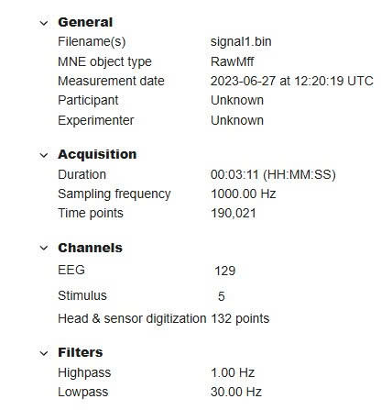
Findings:
Channels overview:
3 misc channels, 1 stimulus, 2 gaze, 1 pupil.
No digitization → limits source localization.
Filter applied:
Acquisition: 0 Hz high‑pass, 500 Hz low‑pass.
Raw signal wide range → preprocessing needed.
Trends and Seasonality:
No long‑term cycles.
Short‑term repeating responses (pupil/gaze) linked to stimuli.
Time-series
Topic 10

Slide 8
Content
Introduction & Dataset description
Analysis & Findings
Issues
Summary
Time-series
Topic 10
Time-series

Slide 9
Issues:
Missing participant info
No head/sensor digitization
Noise/artifacts → require filtering & rejection
Time-series
Topic 10

Slide 10
Content
Introduction & Dataset description
Analysis & Findings
Issues
Summary
Time-series
Topic 10
Time-series

Slide 11
Summary:
Dataset rich in EEG + eye‑tracking, high resolution
Preprocessing needed to address metadata gaps & noise
Next: detailed event‑related analysis
Time-series
Topic 10

Slide 12
Thank you!
Intro to A
Trong-Nghia Nguyen
Time-series
Topic 10
12

